Slide 1


SUPERPOSITION
Quantum Dice Summer Internship Interview
Pedro Faria Albuquerque

Slide 2
Why choose Superposition?
Fundamental concept of Quantum Mechanics;

Slide 3
Why choose Superposition?
Fundamental concept of Quantum Mechanics;
Essential for Quantum Technologies;

Slide 4
Why choose Superposition?
Fundamental concept of Quantum Mechanics;
Essential for Quantum Technologies ;
Showcases knowledge of Quantum Mechanics, of Quantum Dices QRNGs and it can be simulated using qiskit;

Slide 5
Why choose Superposition?
Fundamental concept of Quantum Mechanics;
Essential for Quantum Technologies ;
Showcases knowledge of Quantum Mechanics, of Quantum Dices QRNGs and it can be simulated using qiskit;
It is very interesting!

Slide 6

What is Superposition?
”A property of a quantum system to exist in multiple states
simultaneously, until the quantum system is measured. Superposition is one of the key features of quantum states.”
-Taken from Quantum Dices website

Slide 7

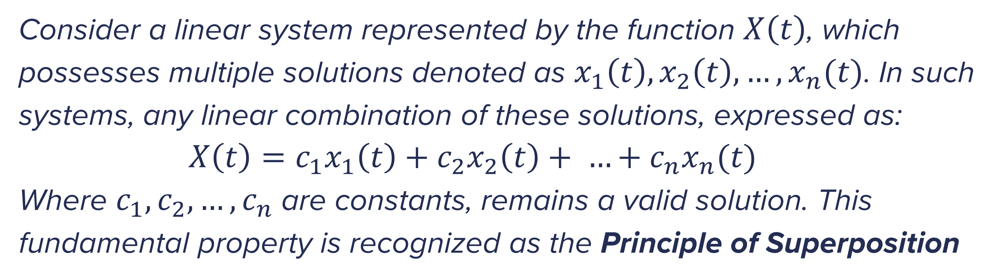
Principle of Superposition
Consider a linear system represented by the function $X\left(t\right)$, which possesses multiple solutions denoted as $x_{1}\left(t\right), x_{2}\left(t\right), …, x_{n}(t)$. In such systems, any linear combination of these solutions, expressed as:
$X\left(t\right)=c_{1}x_{1}\left(t\right)+c_{2}x_{2}\left(t\right)+ …+c_{n}x_{n}(t)$
Where $c_{1},c_{2}, …, c_{n}$ are constants, remains a valid solution. This fundamental property is recognized as the Principle of Superposition

Slide 8
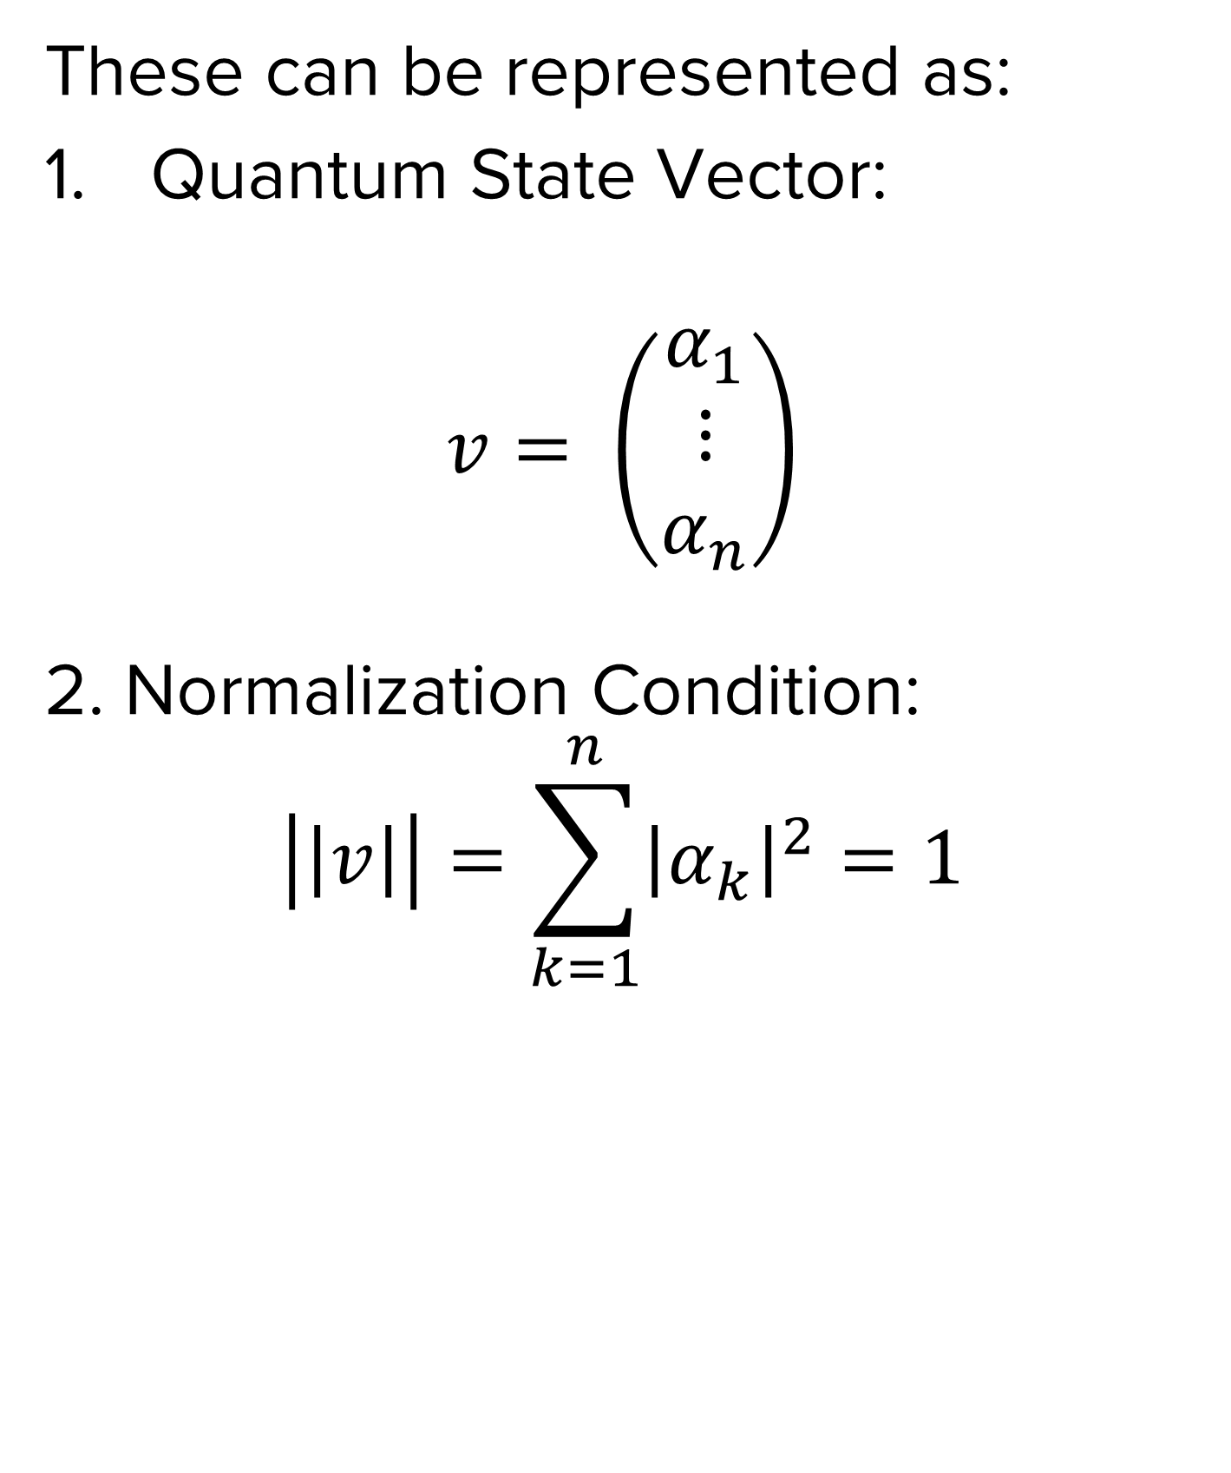
Quantum Mechanics
The components of vectors representing quantum states are characterized by these two properties:
The entries of a quantum state vector are complex numbers;
The sum of the absolute values squared of the entries of a quantum state vector is 1;
These can be represented as:
Quantum State Vector:
$$v= \left(\begin{aligned}α_{1} \\ ⋮ \\ α_{n}\end{aligned}\right)$$
2. Normalization Condition:
$$\left|\left|v\right|\right|=\sum_{k=1}^{n}{{\left|α_{k}\right|}^{2}}=1$$

Slide 9

The Qubit
The qubit is the basic unit of quantum information, analogous to a classical bit in a classical computer:
$$\left|ψ\right\rangle =α\left|i\right\rangle +β\left|j\right\rangle$$
Qubits can also be viewed in the context of NMR with spins:
$$\left|ψ\right\rangle =α\left|UP\right\rangle +β\left|DOWN\right\rangle$$
Or with polarizing beam splitter (PBS):
$$\left|ψ\right\rangle =α\left|T\right\rangle +β\left|R\right\rangle$$
Or as its most known, in the computational basis:
$$\left|ψ\right\rangle =α\left|0\right\rangle +β\left|1\right\rangle$$

Slide 10

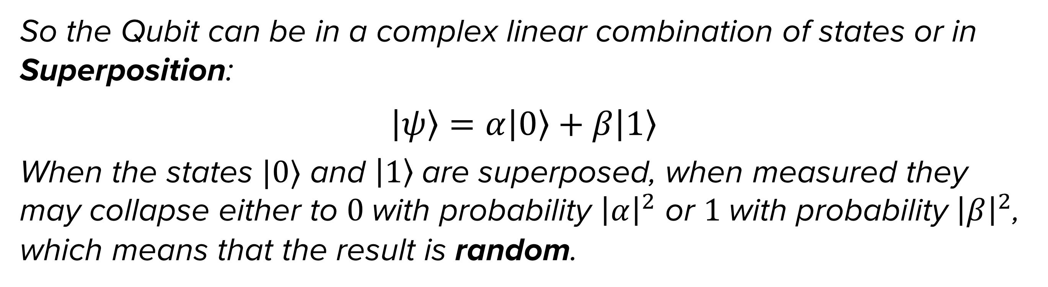
Quantum Superposition
So the Qubit can be in a complex linear combination of states or in Superposition:
$$|ψ〉=α\left|0\right\rangle +β|1〉$$
When the states $|0⟩$ and $\left|1\right\rangle$are superposed, when measured they may collapse either to $0$with probability ${\left|α\right|}^{2}$ or $1$with probability ${\left|β\right|}^{2}$, which means that the result is random.

Slide 11
Generating Random Numbers with Qiskit

Slide 12
Disclaimer
The code used a simulator - AerSimulator(), which attempts to simulate a Quantum Computer, so the Quantum Process did not happen;
No statistical tests to check the randomness of the numbers were done (eg. NIST);
The generation of fast and large amounts of random numbers would not be possible with current Quantum Computers;
To generate true random numbers we need device-independent quantum random number generators, such as Quantum Dice's VERTEX or APEX QRNG, which generate and validate the numbers at high rates.

Slide 13
Thank you!

